Slide 2
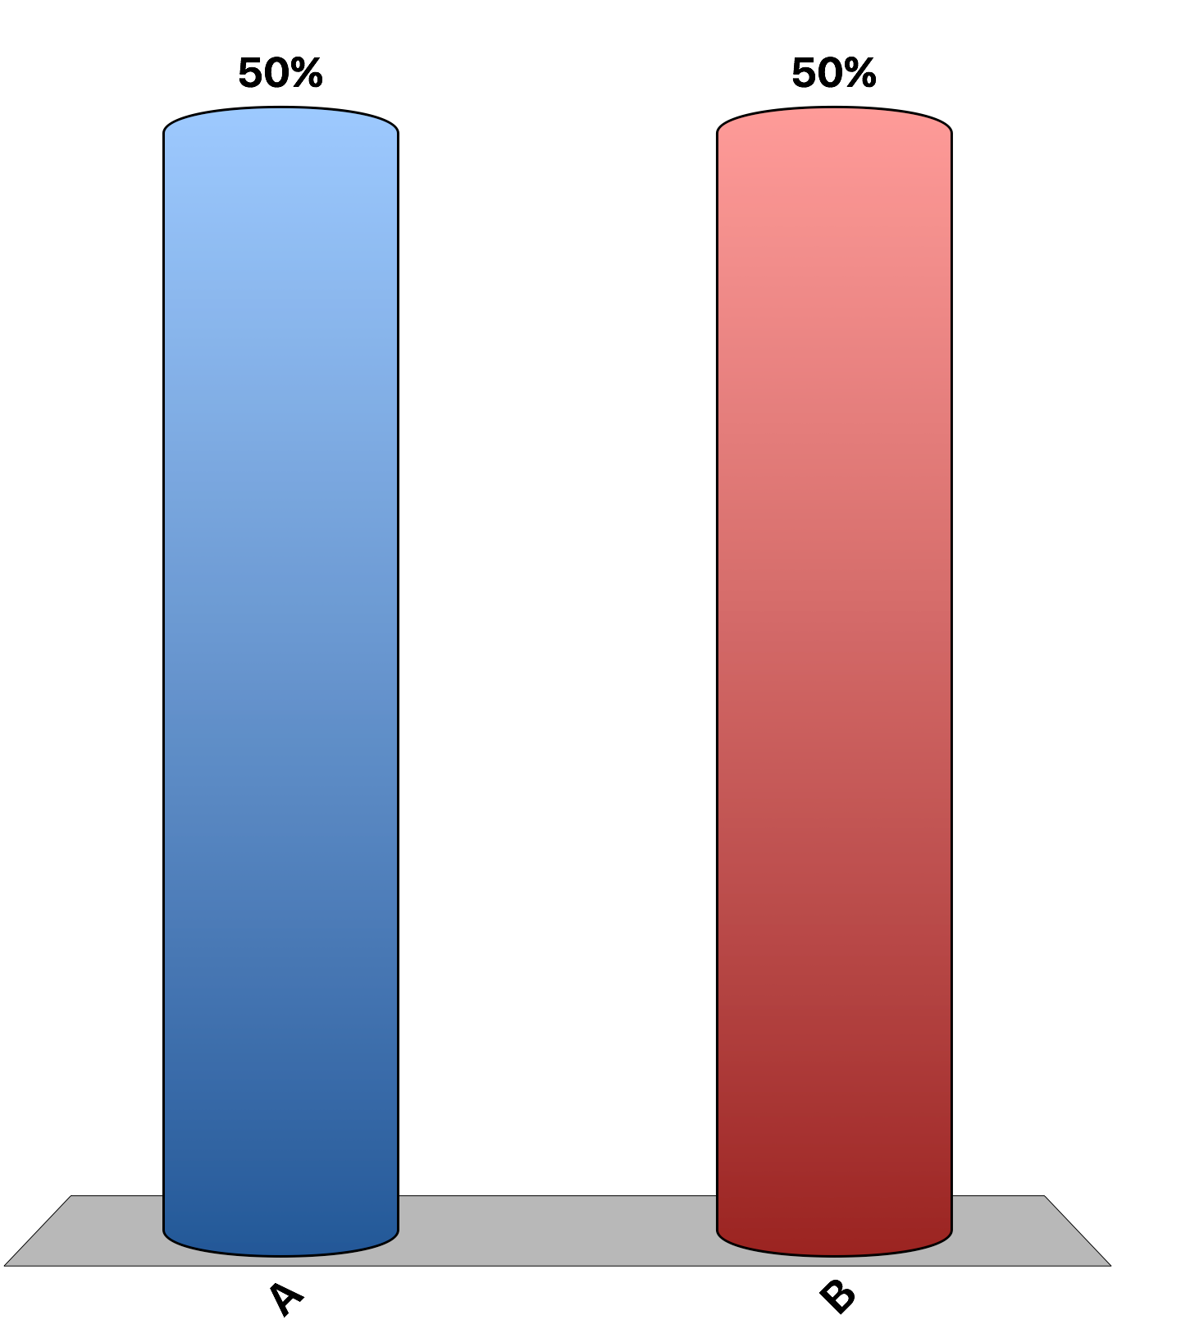
Changes in the price of chocolate cake cause the demand curve for chocolate cake to shift, whereas changes in income cause a movement along the demand curve for chocolate cake.
True
False

Slide 3
A movement along the downward-sloping demand curve for frozen margaritas can be caused by a change in weather.
True
False

Slide 4
Changes in the price of cheese cause a movement along the supply of cheese, whereas changes in input prices cause the supply of cheese to shift.
True
False

Slide 5
If demand decreases, both the equilibrium price and quantity decrease.
True
False

Slide 6
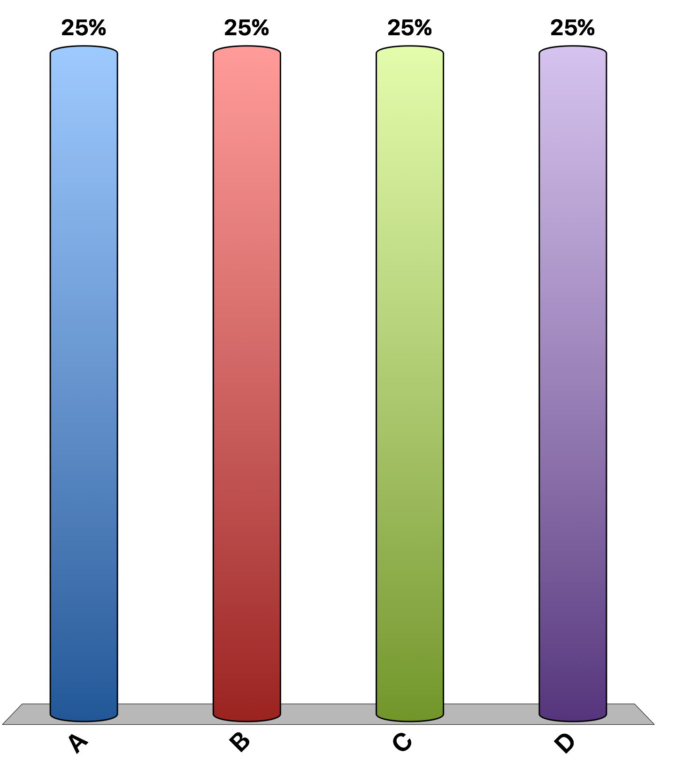
A market is a
series of equilibrium prices for a particular good or service.
series of equilibrium quantities for a particular good or service.
group of buyers and sellers of a particular good or service.
graph of the relationship between the price and quantity of a particular good or service.

Slide 7
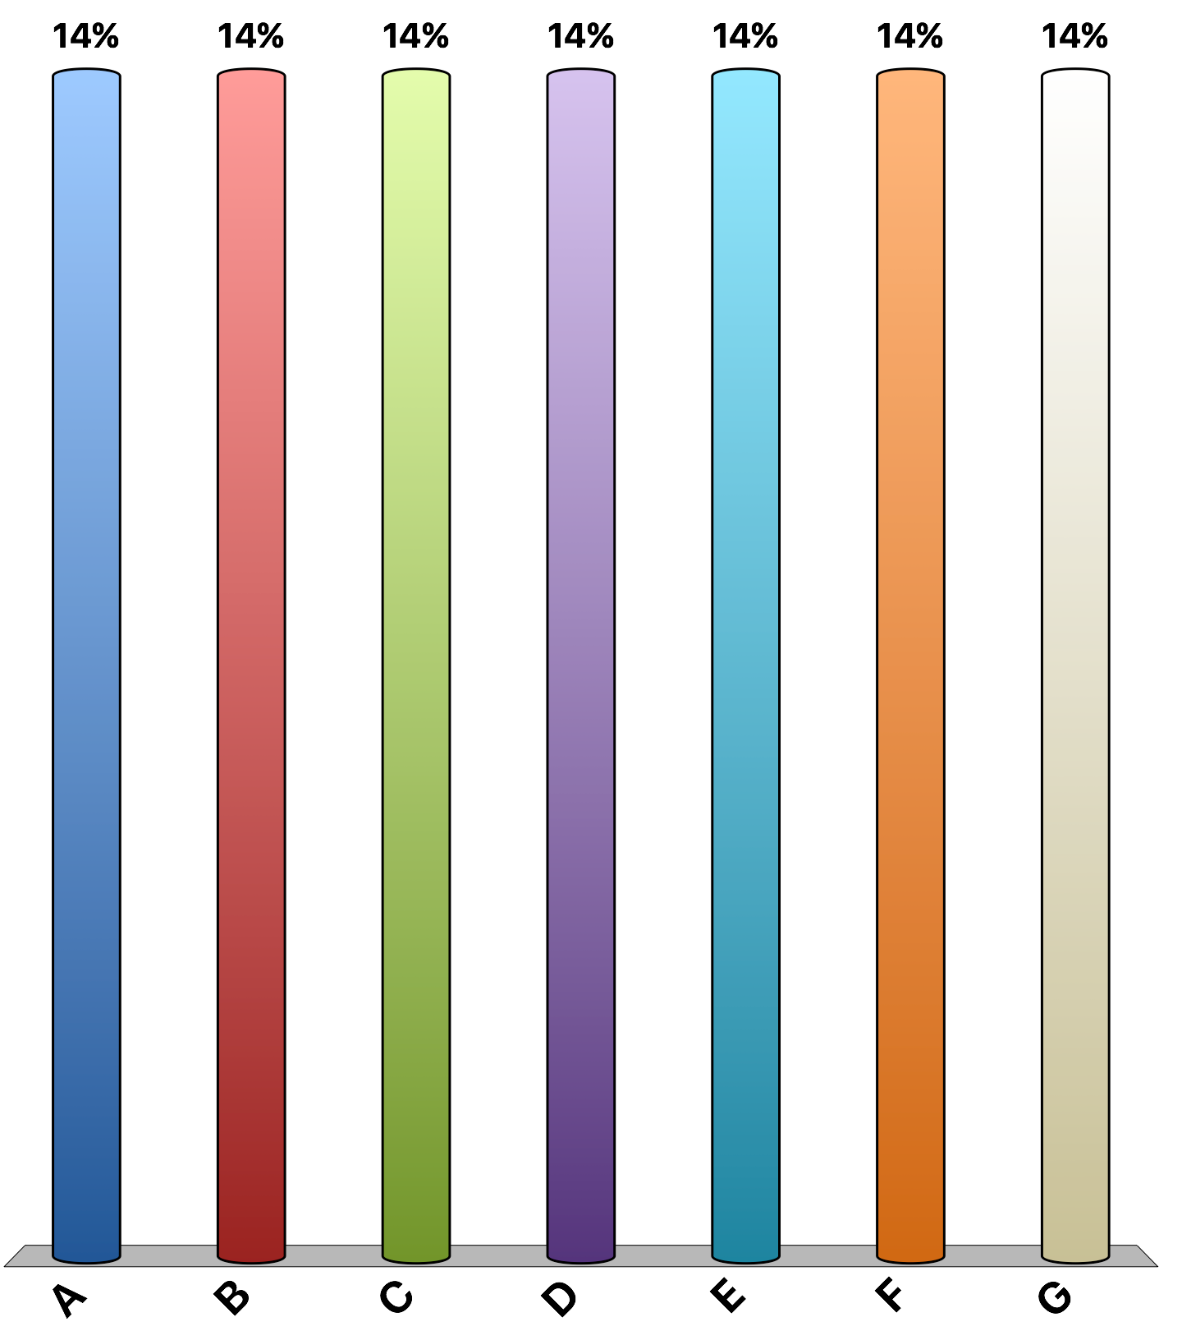
How much would you pay for a front-row ticket to a Maroon 5 concert?
At most $0
At most $5
At most $20
At most $50
At most $100
At most $500
More than $500
Notes:
Construct a demand curve from this information.

Slide 8
Assuming apricots and nectarines are substitutes for peaches. Which of the following would shift the demand curve for peaches to the right?
an increase in the price of apricots
a decrease in the price of nectarines
an increase in the price of peaches
a decrease in the income of peach buyers, assuming peaches are a normal good

Slide 9
Which of the following is an example of the law of demand?
A technological innovation enables ABC Medical Company to produce more blood-sugar meters at every price.
When the price of bagels rises, Bloomington Bagel Company is willing to sell more bagels.
As the temperature rises, consumers purchase more lemonade.
When tuition at State U rises, fewer students enroll in courses at State U.

Slide 10
How much payment would you require to shave your head?
I would do it for less than $20
Minimum $20
Minimum $50
Minimum $100
Minimum $500
Minimum $1000
Minimum more than $1000
Notes:
Construct a supply curve from this information.

Slide 11
In 1971 a pocket calculator cost more than $75. In 2015 a calculator of the same quality cost less than $10. Which of the following explanations is most consistent with these facts?
an increase in the demand for calculators
a change in technology
an increase in income, given that calculators are a normal good
a decrease in supply

Slide 12
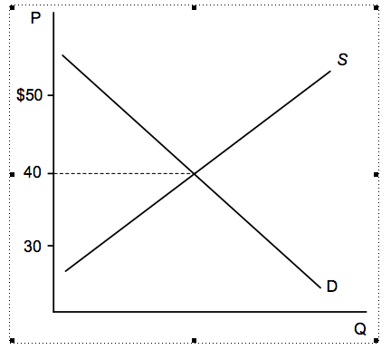
This graph illustrates the market for fine wine. If the current price is $50 per bottle, we expect the
price to decrease due to the surplus of wine.
price to increase due to the shortage of wine.
supply to shift left until the equilibrium price is $50.
demand to shift left until the equilibrium price is $50.

Slide 13
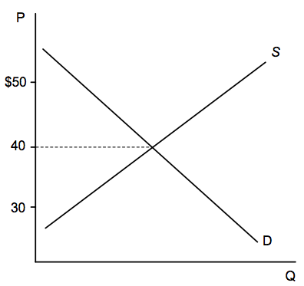
This graph illustrates the market for gluten free chocolate cake. If the current price is $30 per cake, we expect the
price to decrease due to the surplus of cake.
price to increase due to the shortage of cake.
supply to shift right until the equilibrium price is $30.
demand to shift left until the equilibrium price is $30.

Slide 14
An advance in technology would shift the
supply curve to the right.
supply curve to the left.
demand curve to the right.
demand curve to the left.

Slide 15
Which of the following would shift the supply curve of iPhones to the right?
a decrease in wages paid to workers making the iPhones.
more advertising for iPhones .
an increase in the price of iPads
an increase in the price of iPhones

Slide 16
Suppose that cold temperatures cause a decrease in the supply of tea. What should happen in the market for coffee, assuming tea and coffee are substitutes?
The equilibrium price will increase, and the equilibrium quantity will decrease.
The equilibrium price will decrease, and the equilibrium quantity will increase.
Both the equilibrium price and quantity will increase.
Both the equilibrium price and quantity will decrease.

Slide 17
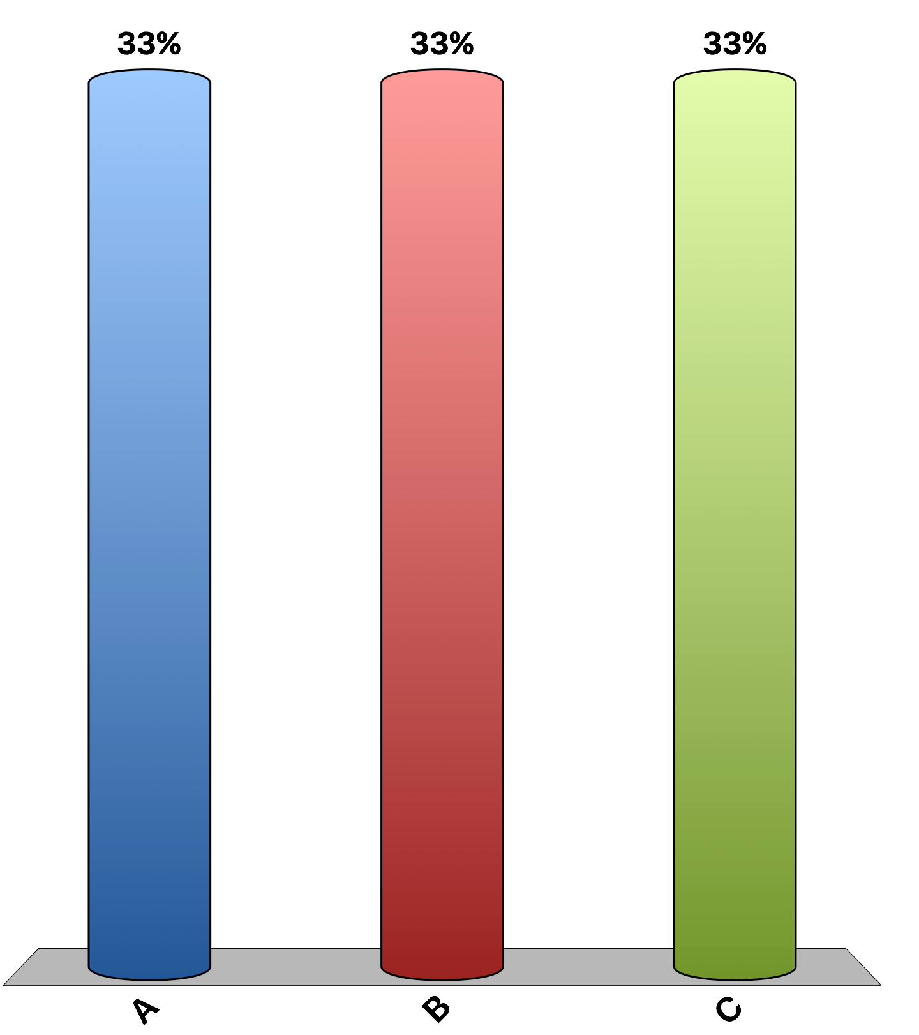
“Connecticut should pass its Senate Bill 60, which states that during a 'severe weather event emergency, no person within the chain of distribution of consumer goods and services shall sell or offer to sell consumer goods or services for a price that is unconscionably excessive.”
agree
disagree
uncertain
Notes:
77% of economists disagree, 7% agree, and 17% are uncertain. This is the 'Ask the experts' feature in the textbook. Source: IGM Economic Experts Panel, May 2, 2012.

